Slide 1
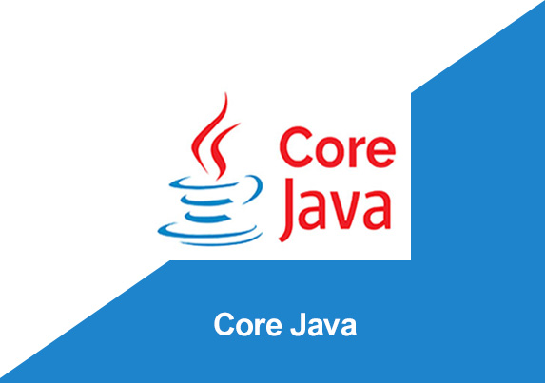
By: Manas Tuwani

Slide 2
LOOPING STATEMENTS
We are using looping statements to execute same lines of code for multiple times in a java program. By default, when we execute program, it will execute only for one time. If we want to execute for multiple times, that is possible with the help of looping statements.
We are using 4 different looping statements in java
1. For loop
2. Nested for loop
3. While loop
4. do-while loop

Slide 3
For Loop
We are using for loop to execute same lines of the code for specific number of times.
Syntax:
for (initialization; condition; increment/decrement) {
Statements;
}

Slide 4
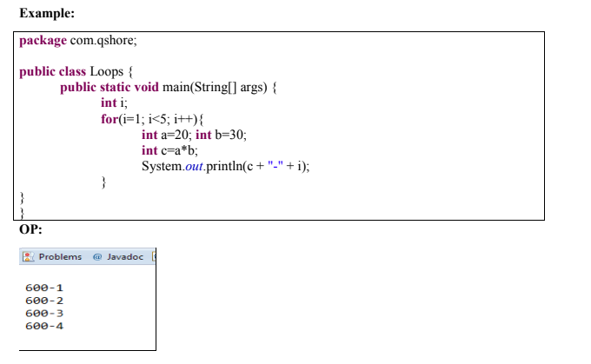

Slide 5
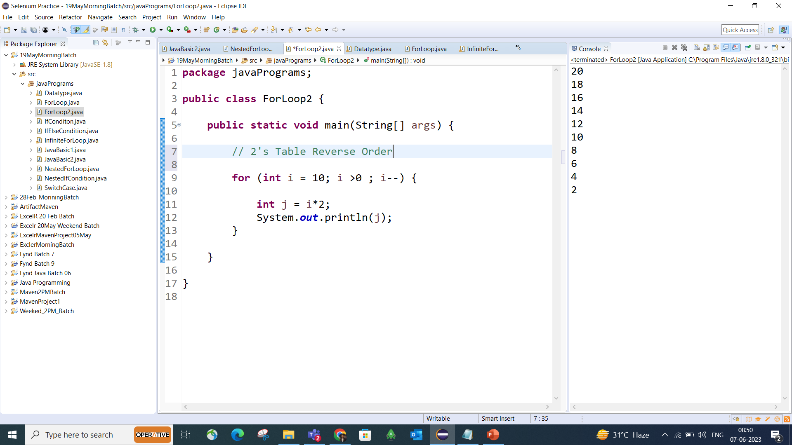
Table

Slide 6
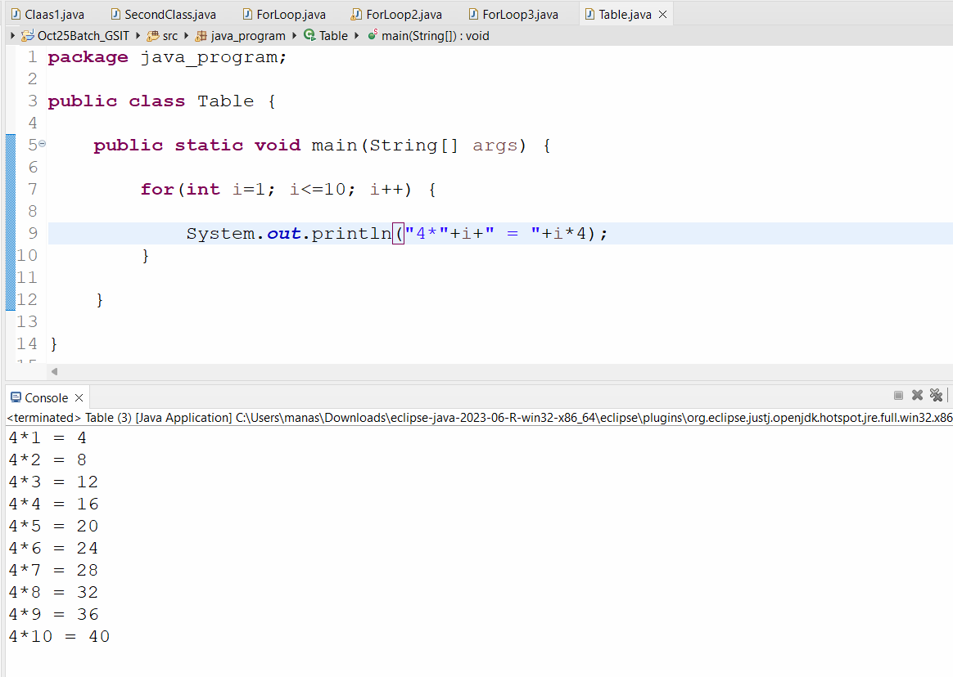

Slide 7
Nested for loop
In nested for loop we are inserting one for loop inside another for loop. Execution starts always from main loop, it goes to sub loop, complete the sub loop all the iterations then it comes back to main loop.
Syntax:
For (Initialization; Condition; Increment/Decrement) {
For (Initialization; Condition; Increment/Decrement) {
For (Initialization; Condition; Increment/Decrement) {
Statements;
} } }

Slide 8
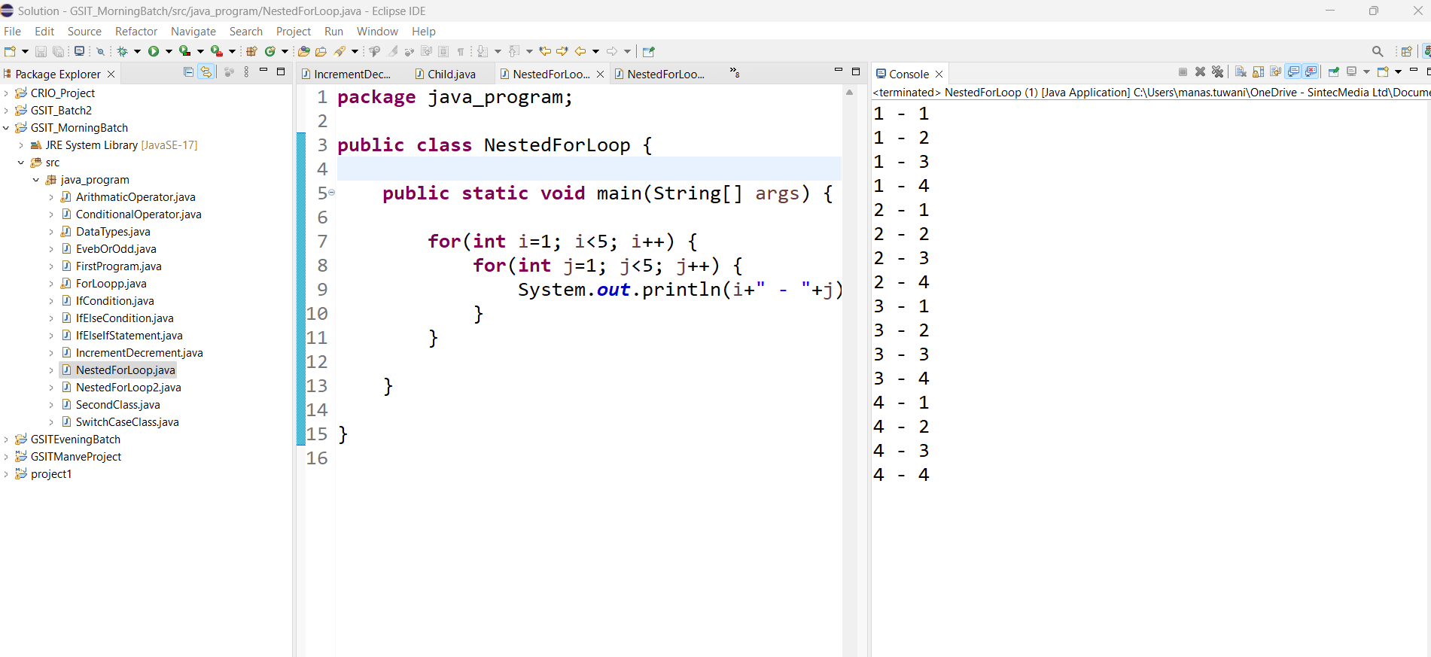

Slide 9
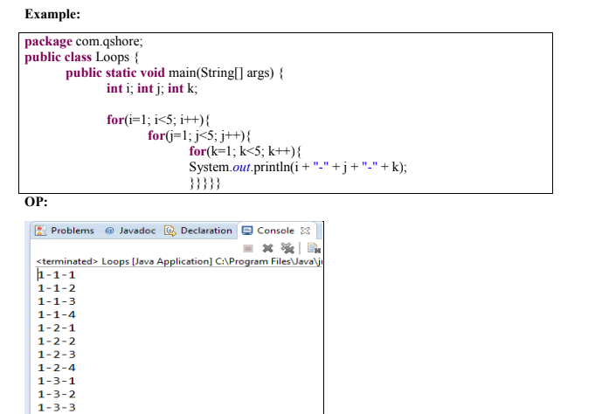

Slide 10
Infinite For Loop
If we use double semicolon in for loop, it will be executed infinite times.
Syntax:
for ( ; ; ) {
Statements;
}

Slide 11
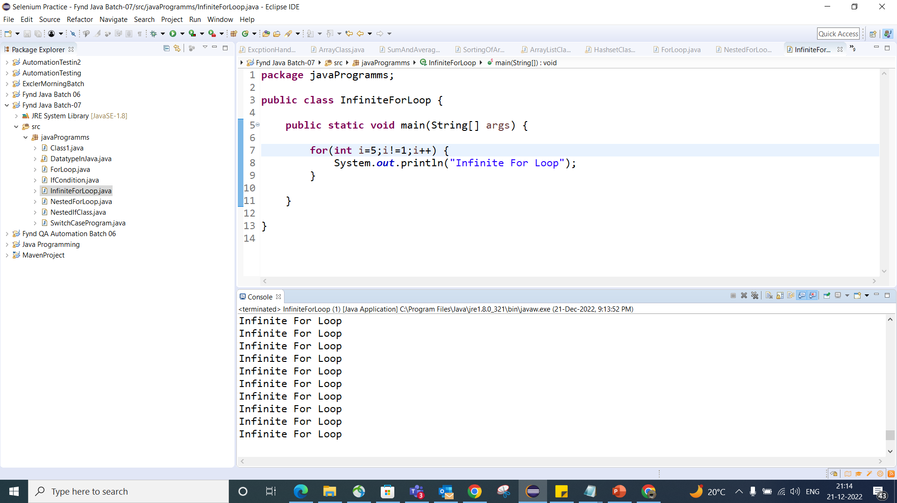

Slide 12
While loop
We are using while loop to execute the same lines of the code for multiple times until the condition is satisfied.
Syntax:
While (condition) {
Statements;
Increment/decrement ; }

Slide 13
While loop
package whileloop;
public class While_Loop {
public static void main(String[] args) {
int n =1;
while(n<10)
{
System.out.println("n is "+n);
n++;
}
}
}

Slide 14
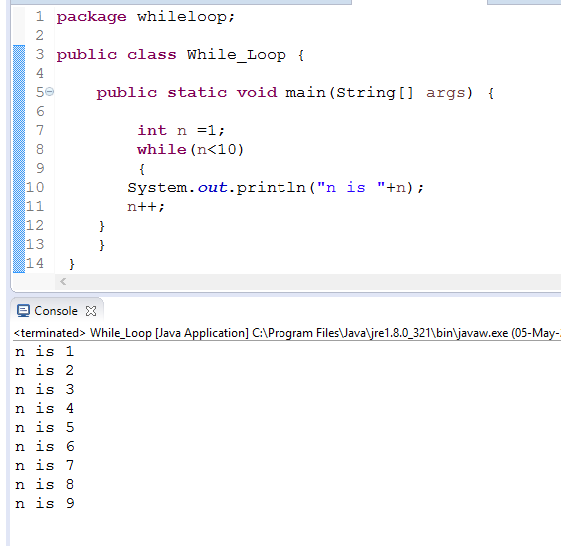

Slide 15
Infinite While Loop
We can also create infinite while loop by passing true as the test condition.
While (true) {
SOP("Infinitive While Loop");
}

Slide 16
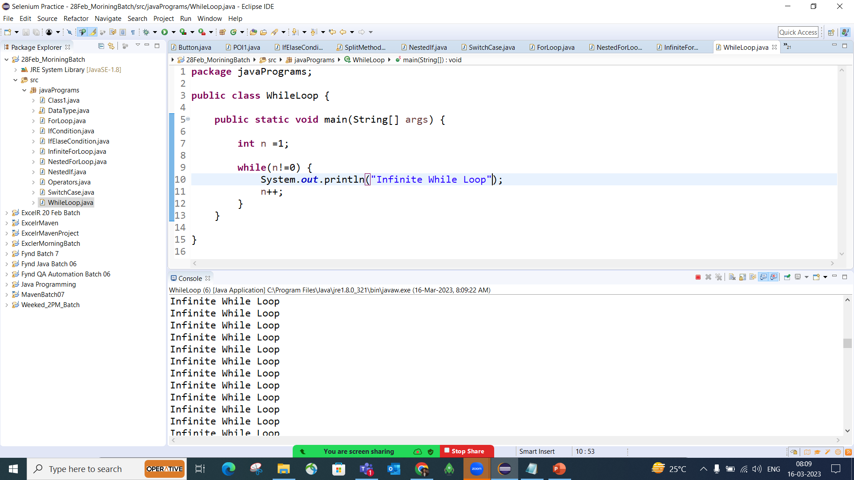

Slide 17
Do while Loop
Do-while loop is similar to while loop except the fact that it guaranteed to execute at least once.
Note: The do block is executed at least once, even if the condition is false.
Syntax:
do {
-----------// Code //-------
}
while(condition);

Slide 18
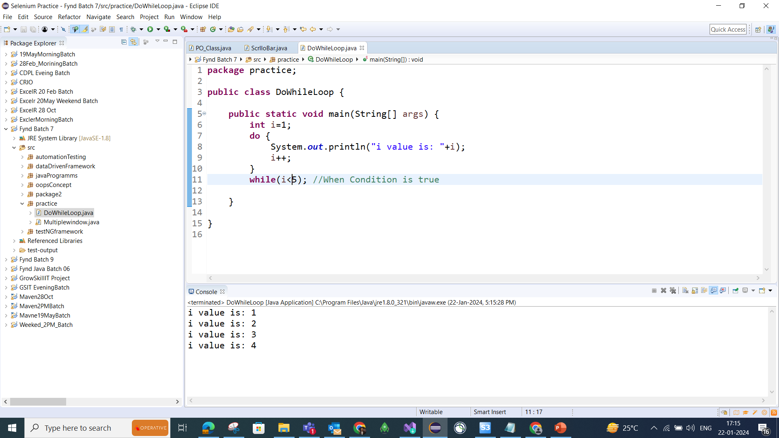

Slide 19
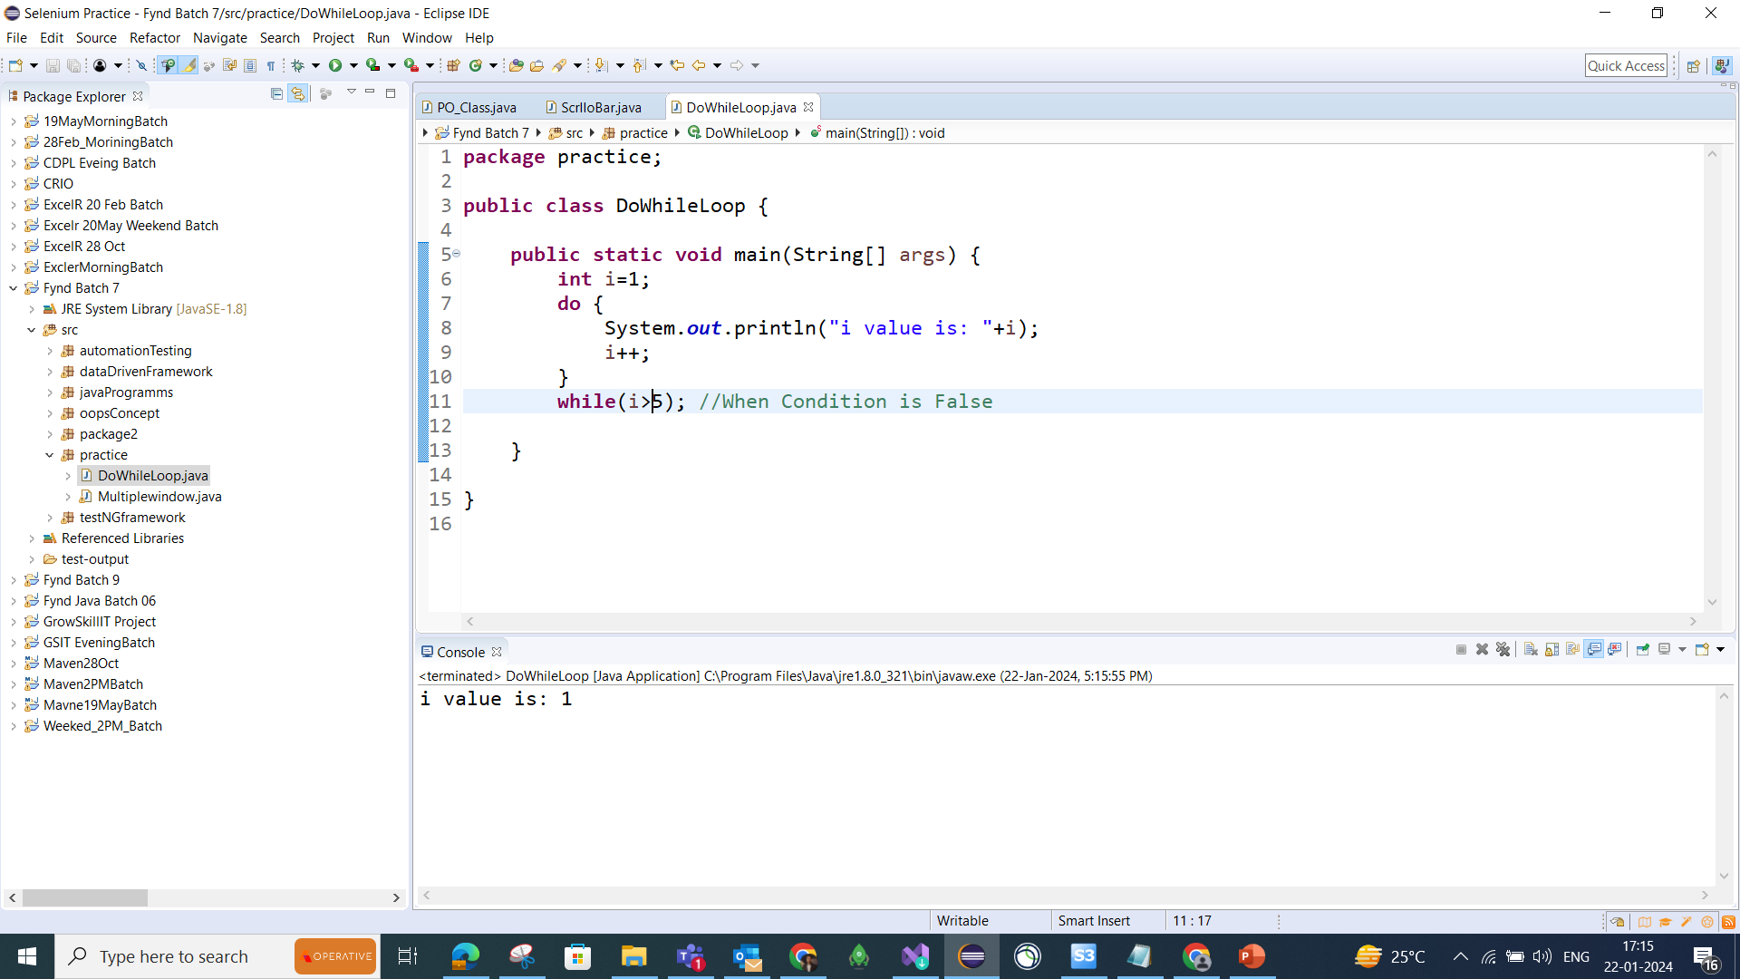

Slide 20
Note:
While: Check the condition and execute the code
Do-while: Execute the code than check the condition

Slide 21
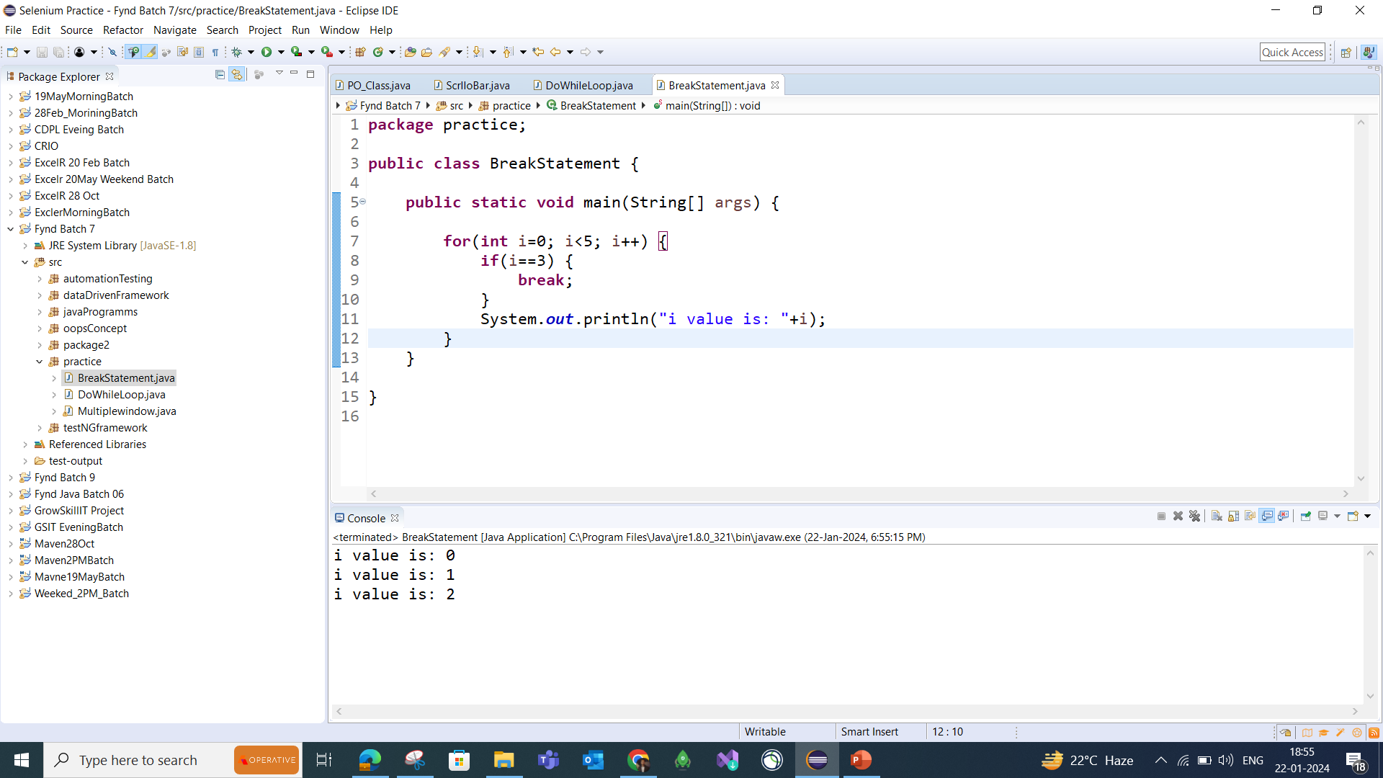
Break Statement
The break statement is used to exit the loop irrespective of whether the condition is true or false.
The break statement is used inside loops or switch statement.

Slide 22
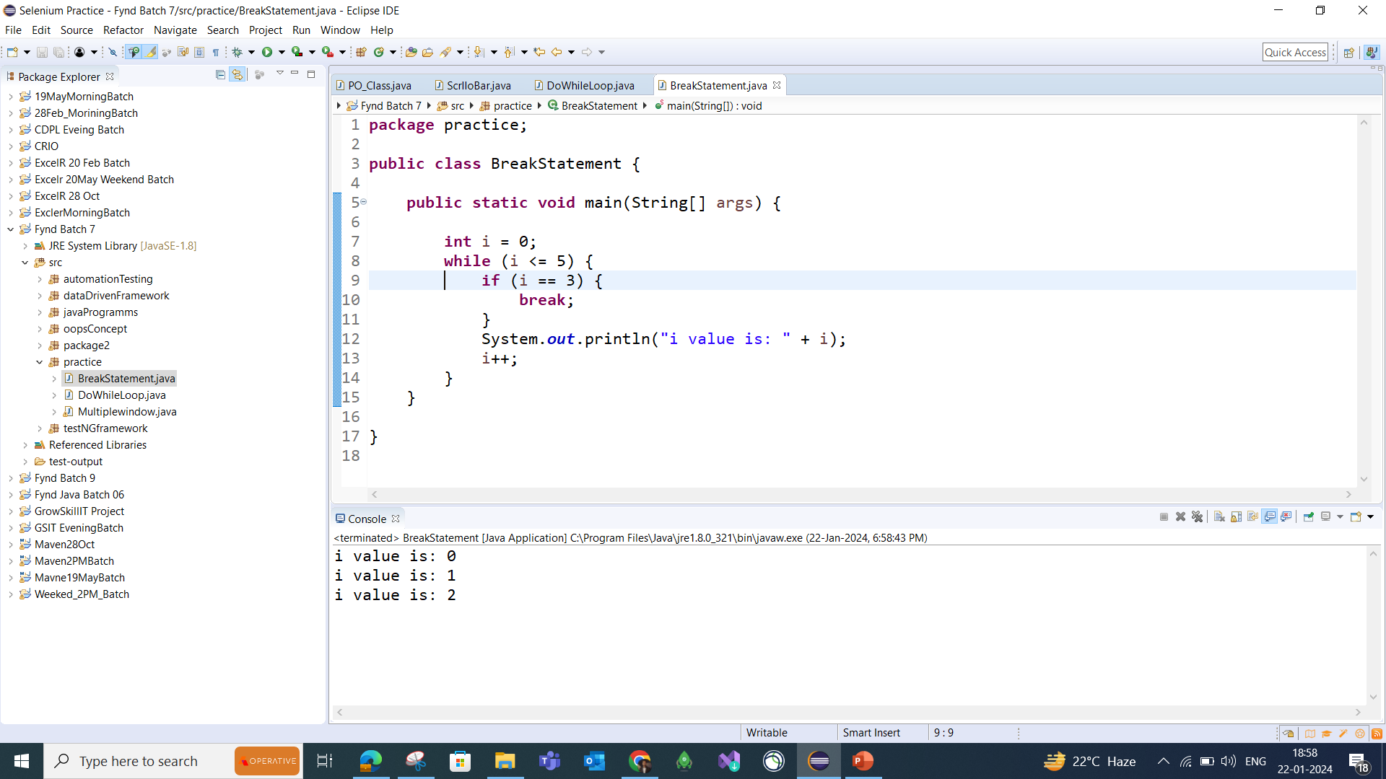
Break Statement with while loop

Slide 23
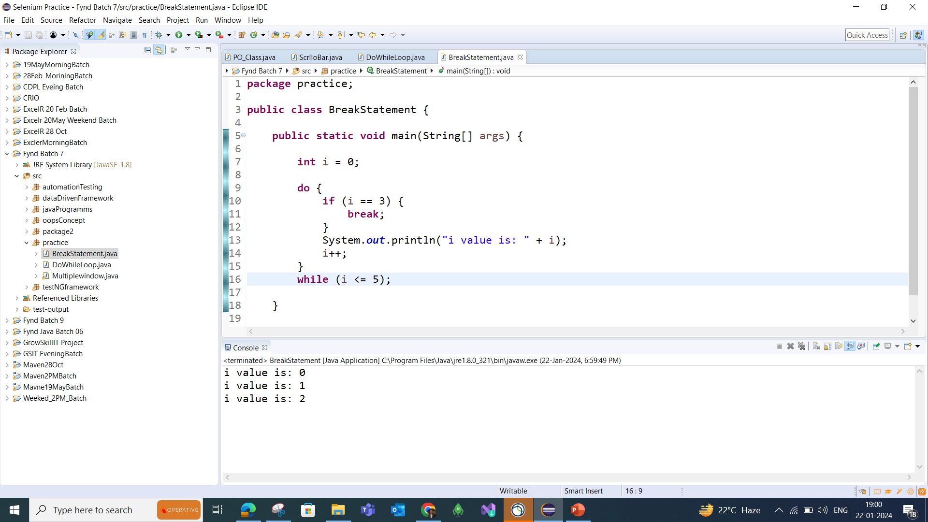
Break Statement with do-while loop

Slide 24
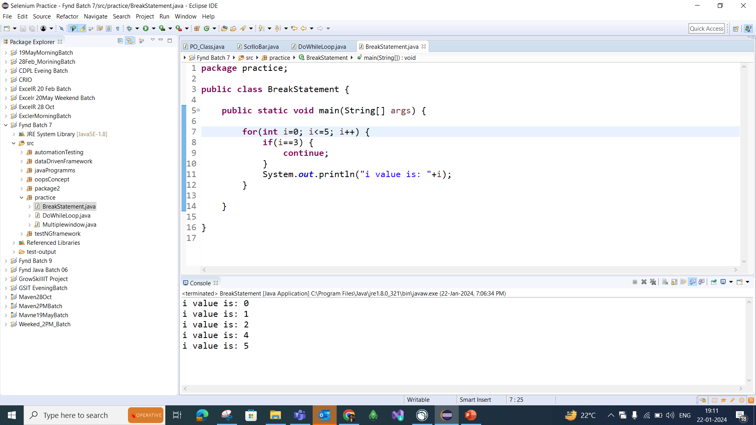
Continue Statement
The Continue statement is used to immediately move to the next iteration of the loop. The control is taken to the next iteration.
Thus, skipping everything below ‘continue’ inside the loop for the iteration

Slide 25
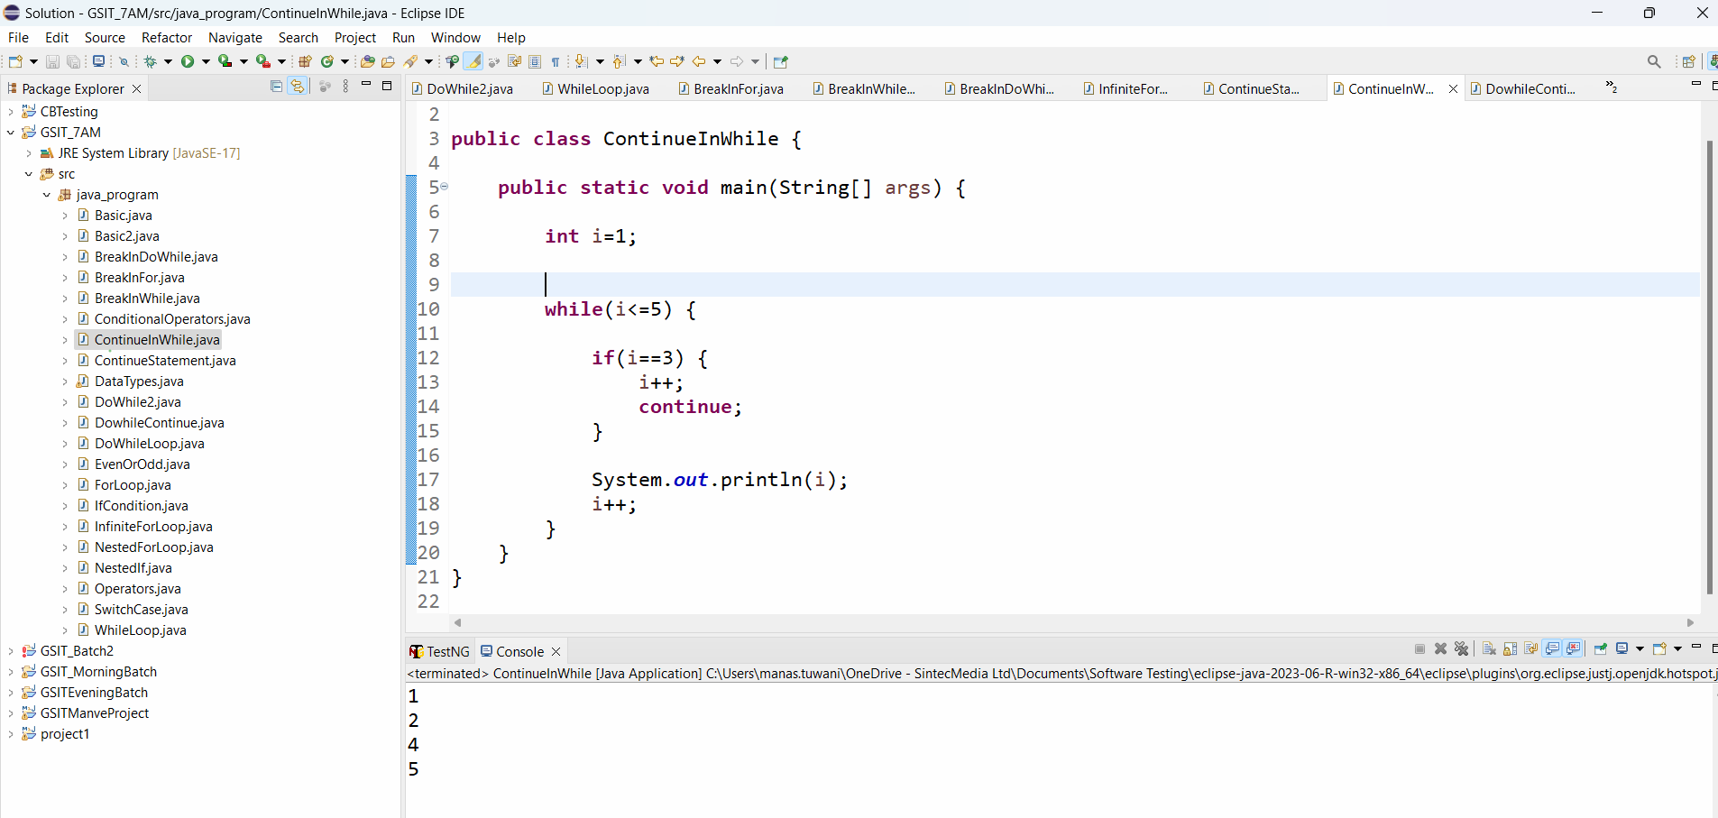
Continue Statement with while loop

Slide 26
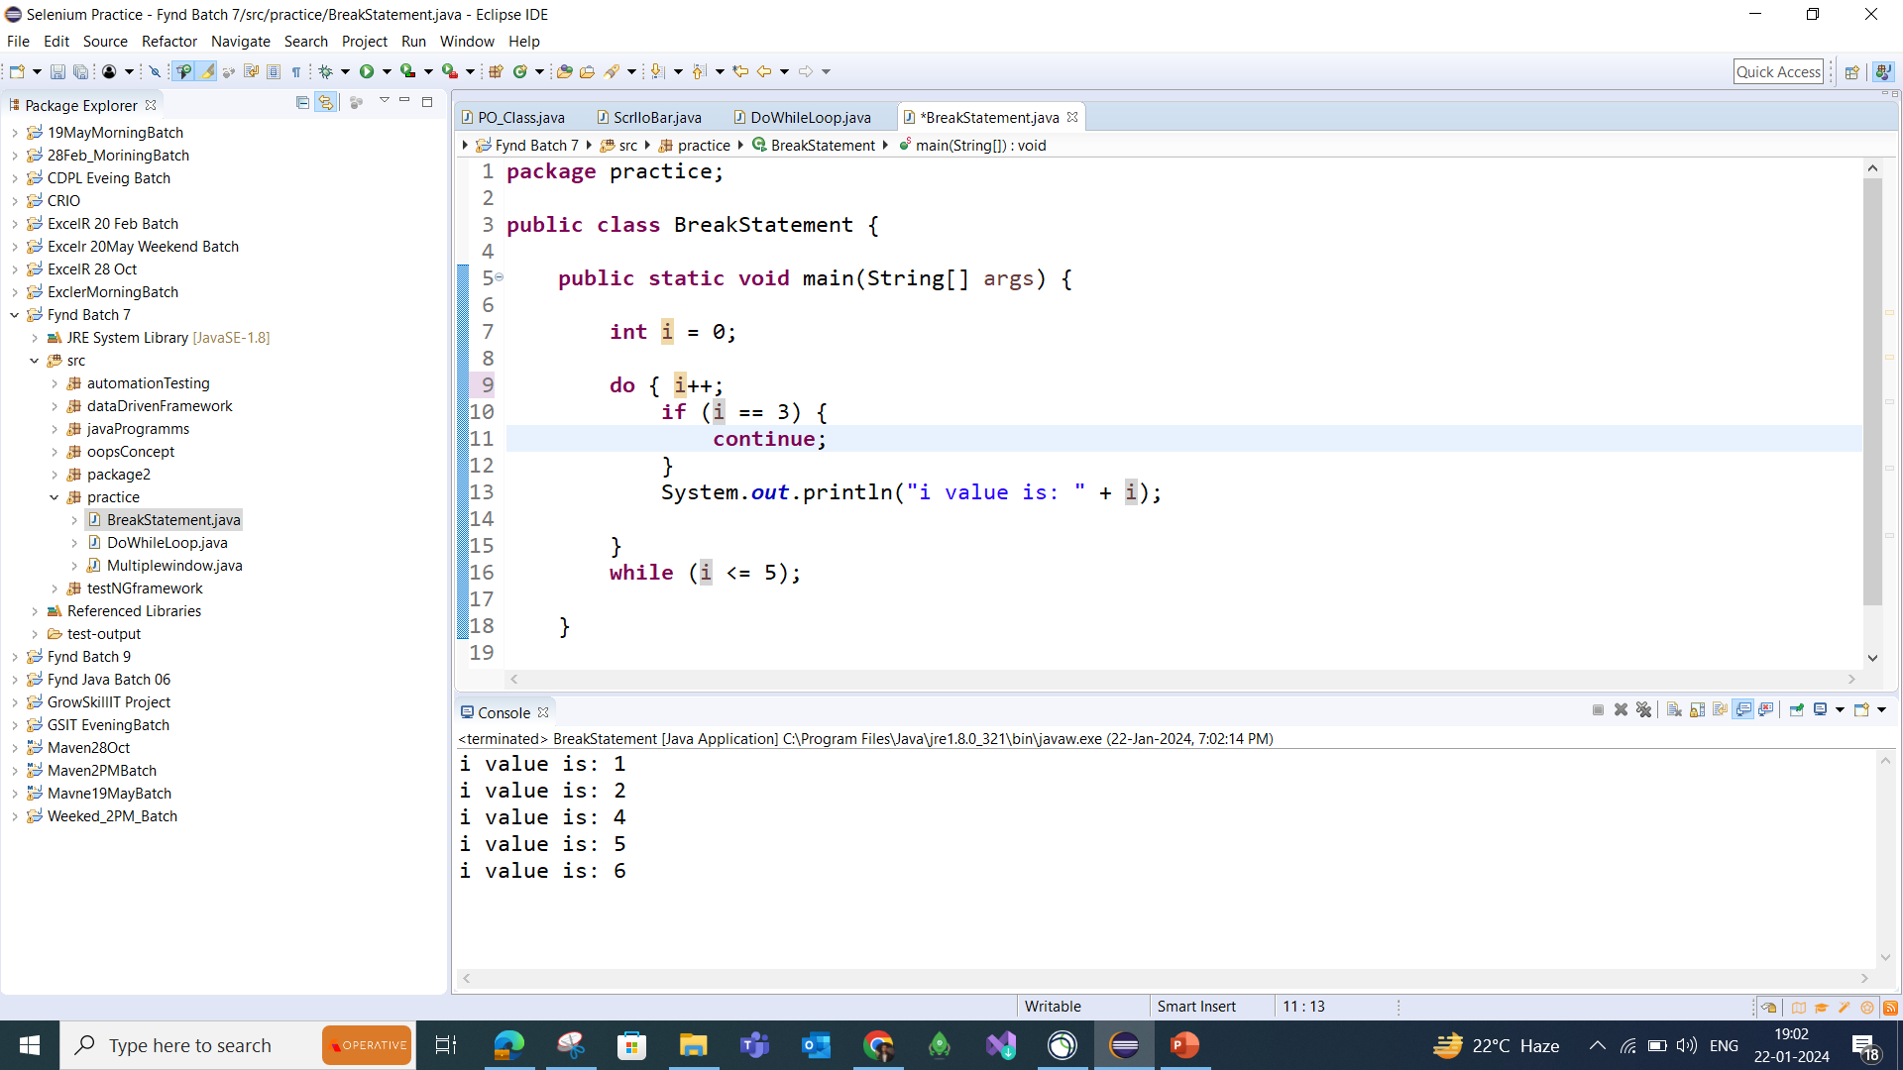
Continue Statement with do-while loop

